Slide 1

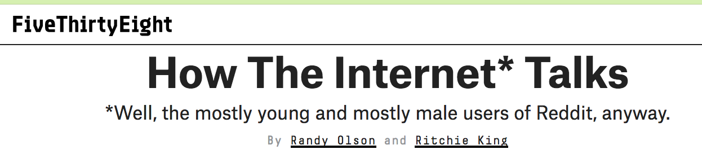
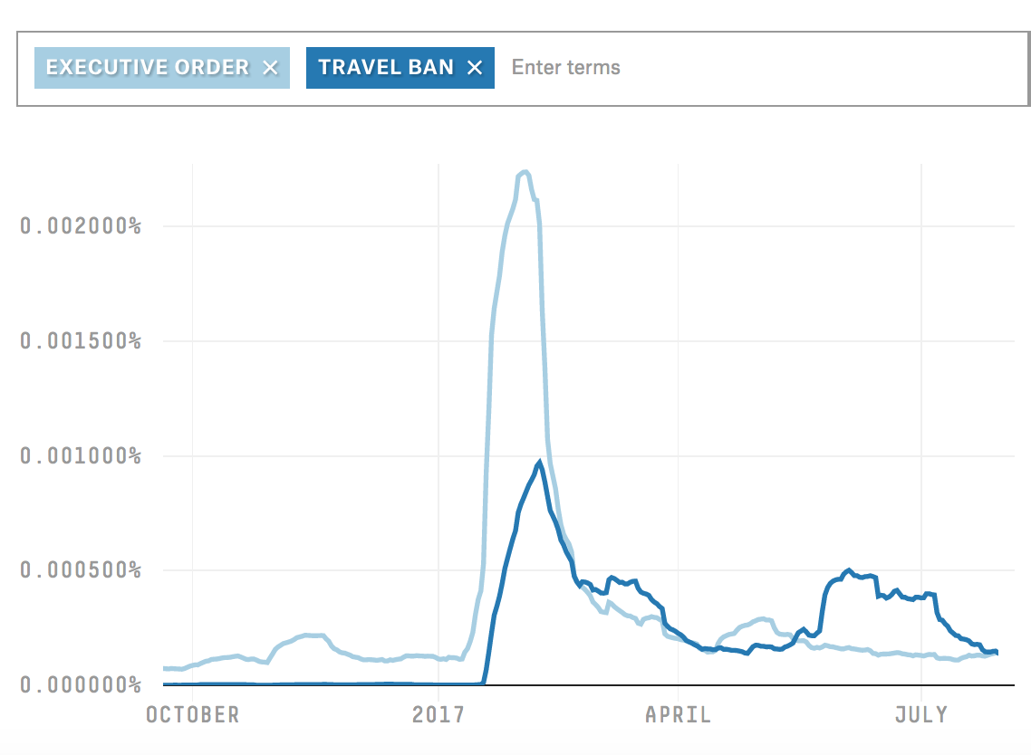
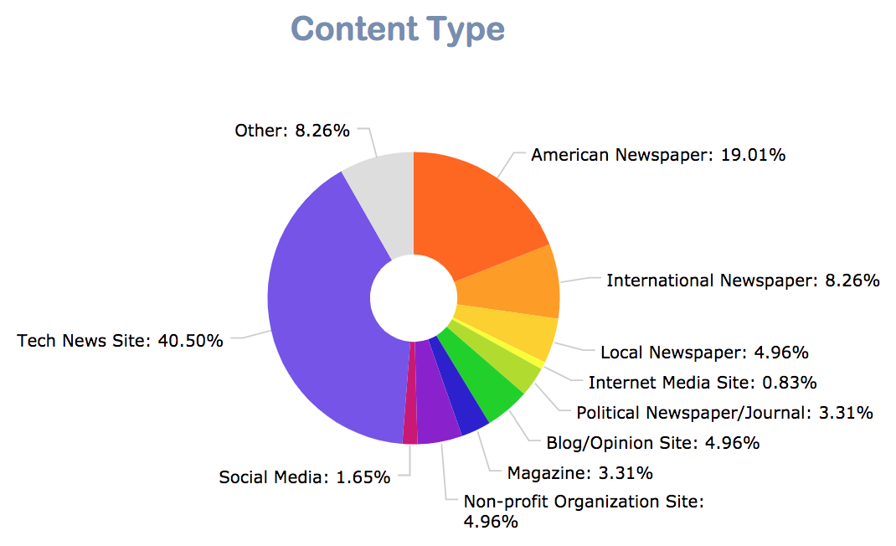
Upvoted and Unbiased?
A textual analysis of “top” vs “controversial” Reddit headlines
Jessica Zheng ‘19 Advisor: Professor Brian Kernighan
1. Motivation
4a. Topic Modeling
5. Findings
Goal: Create a data visualizer that compares and contrasts
Top-rated and Controversial-rated Reddit headlines.
Users draw their own conclusions about how Reddit treated major events over the data collection period.
Las Vegas shooting, Net Neutrality debate etc.
Existing Reddit visualizers
do not account for
post popularity, instead
consider all posts.
Problem: Statistics are computed from
content that is not meaningful or
impactful on Reddit users – as
few as 5% of submitted content
actually becomes popular.
4b. Positive-Negative Sentiment Analysis
NLTK’s VADER Sentiment Analysis was a good starting point
Challenge: VADER does not handle negative operators
E.g. “Patients unwillingly treated with electroshock at Norwegian mental hospitals” predicted a neutral (zero) score
Solution: Re-run neutral-scored headlines through IBM Watson’s Sentiment Analyzer (which handled negative operators) to obtain a second measurement.
2. Approach
Analyze Top-rated and Controversial-rated Reddit headlines via:
topic modeling
positive-negative sentiment analysis
political sentiment analysis
content source breakdown
keyword frequency
Subreddits used: r/politics, r/news, r/worldnews, r/technology
Data collection period: October 1st 2017 to November 18th 2017.
Observe patterns between analysis measures and indicators of
content popularity (“top” or “controversial”, post score, number
of comments)
4c. Political Sentiment Analysis and Shortcomings
Indico.io Text Analysis Service’s API had limited accuracy
Negative operators: “I don’t care for Trump.” scores more highly on conservative leaning than liberal leaning.
Somewhat better at detecting liberal/conservative people and topics, rather than liberal-conservative leanings
Machine learning has lots of room for improvement!
6. Usability Evaluation
Effectiveness of analysis tool:
4/5 users drew the same conclusions I did for Las Vegas Event
5/5 users drew the same conclusions I did for the WPA2 event
Usability issues were mostly concerned with learnability (easily resolved) and limitations of the sentiment analysis tools.
3. Implementation
4d. Other Analysis Measures
Content Source Breakdown
Keyword Frequency in Headlines
7. Conclusions and Future Work
Topic model and keyword frequency visuals were most informative
Machine learning still has room to go for sentiment analysis
Implications:
For known controversial topics, Reddit moderators can intervene and promote healthy discussion
Future Work: Combine multiple analysis forms in the same visual, create improved sentiment classifiers, explore more subreddits.
Notes:
Topic model and keyword frequency was most informative
Positive-Negative sentiment was less insightful
Implications:
For known controversial topics, Reddit moderators can intervene and promote healthy discussion.

